Slide 1
Database in the Cloud Part II
Dr. Leon Jololian

Slide 2
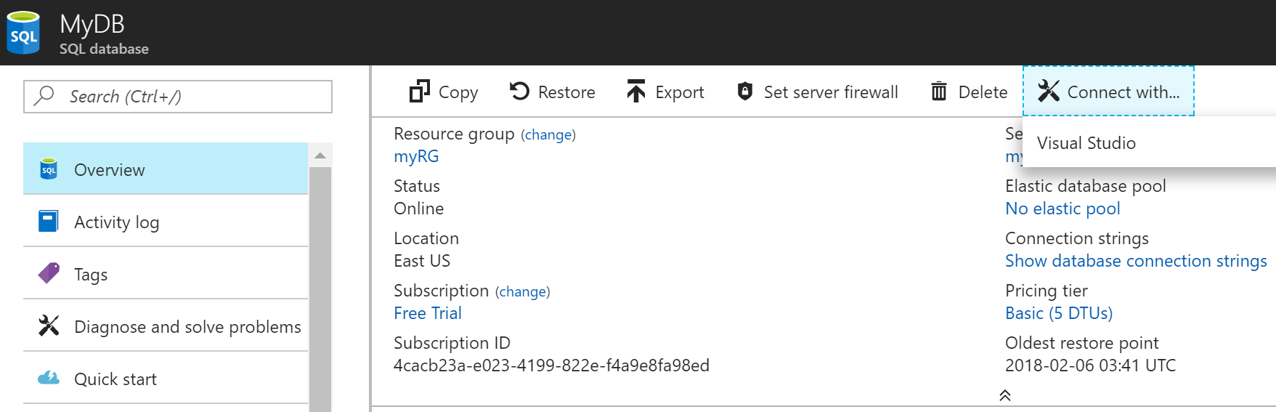

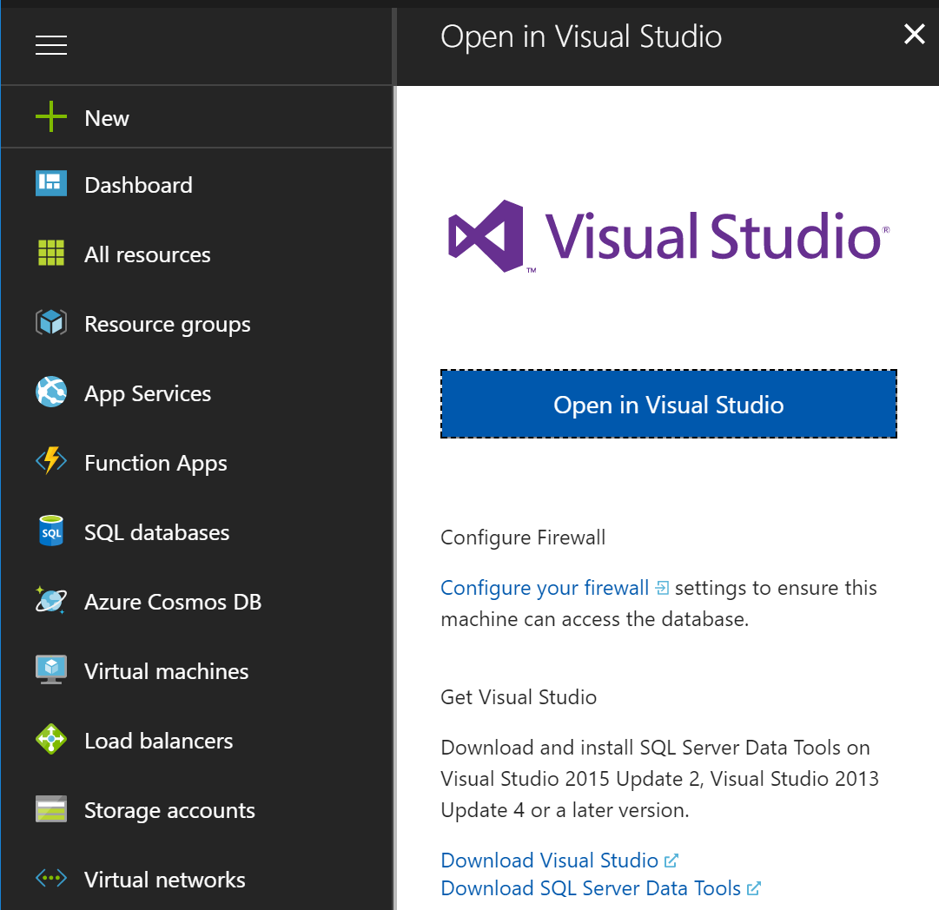
Accessing the Database with VS

Slide 3
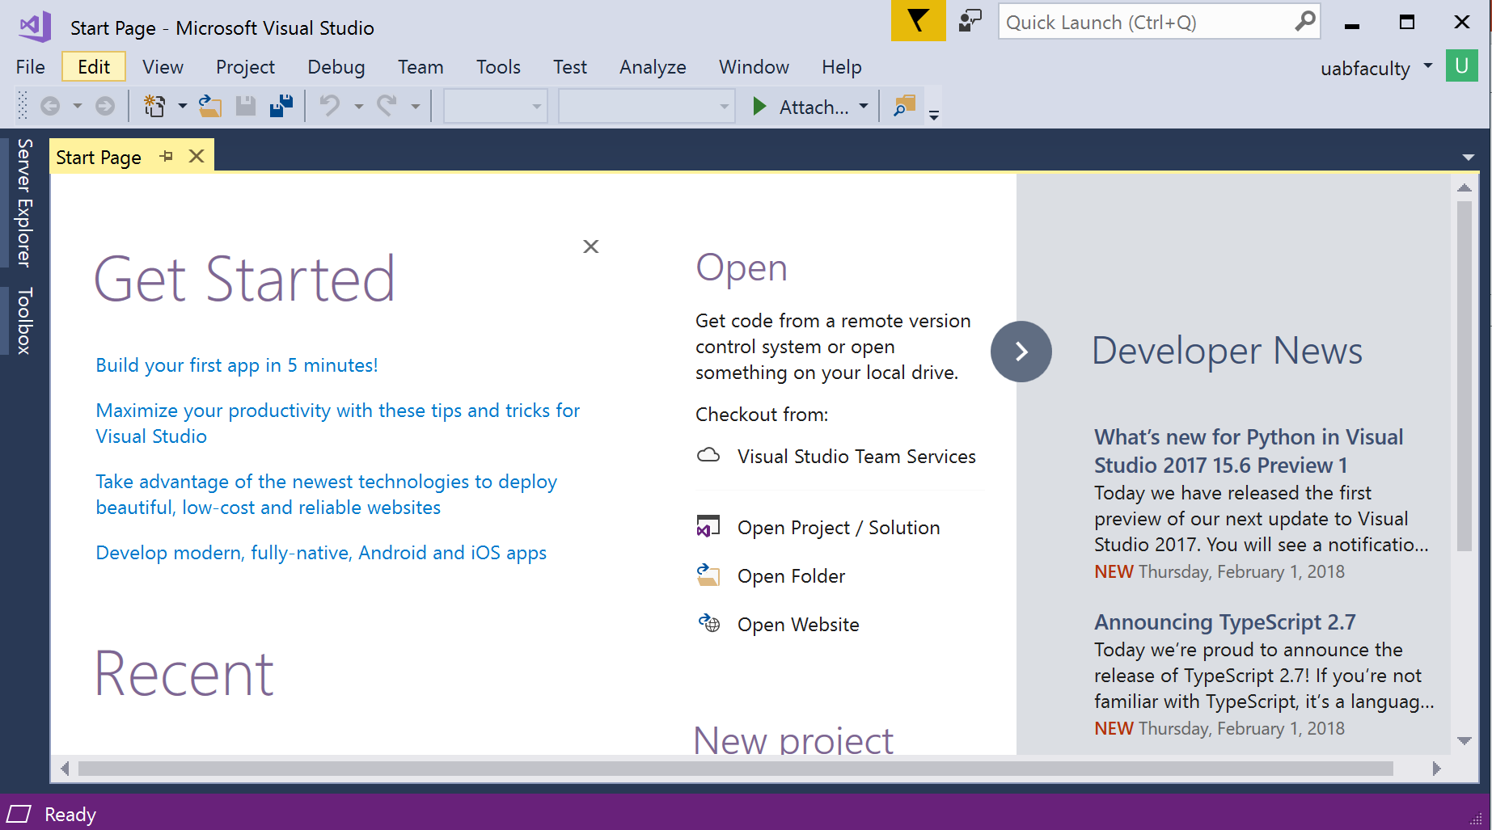
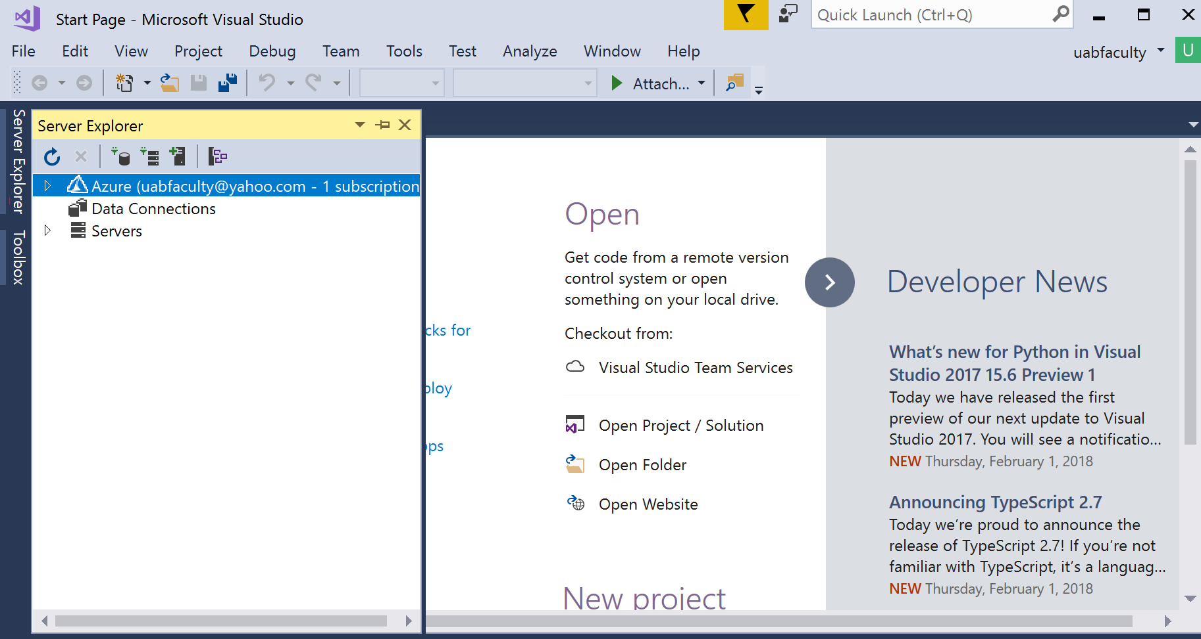
Logged in user
Server Explorer

Slide 4
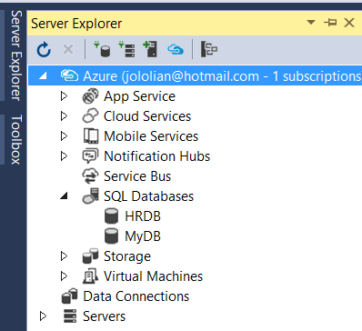
Accessing DB in VS-2017
If not present, select from “View”
Make sure you are Logged in
List of created Databases
Right click and select “Open in SQL Server Object Explorer”

Slide 5
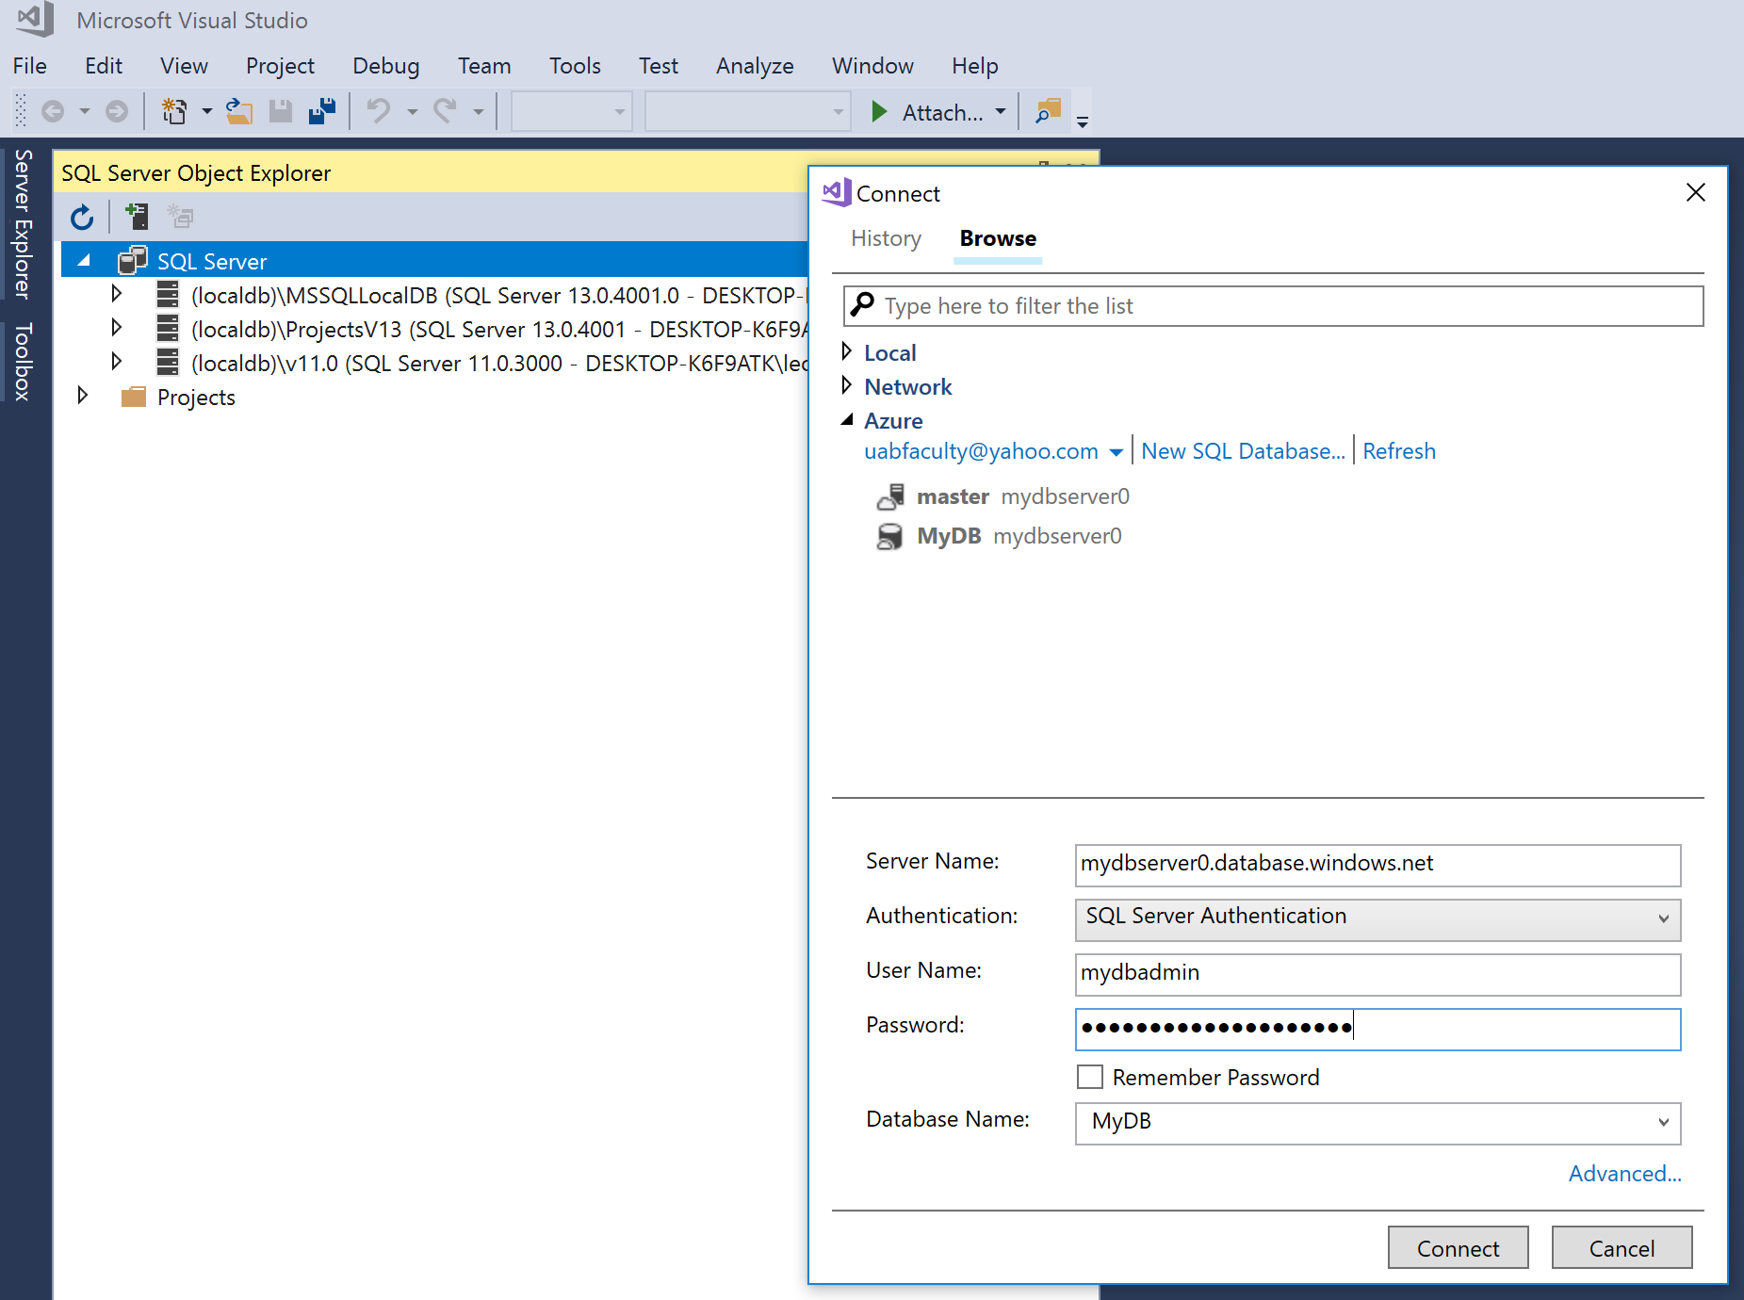
If you don’t see your DB server under “SQL Server”, Right-Click on “SQL Server” → “Add SQL Server”

Slide 6
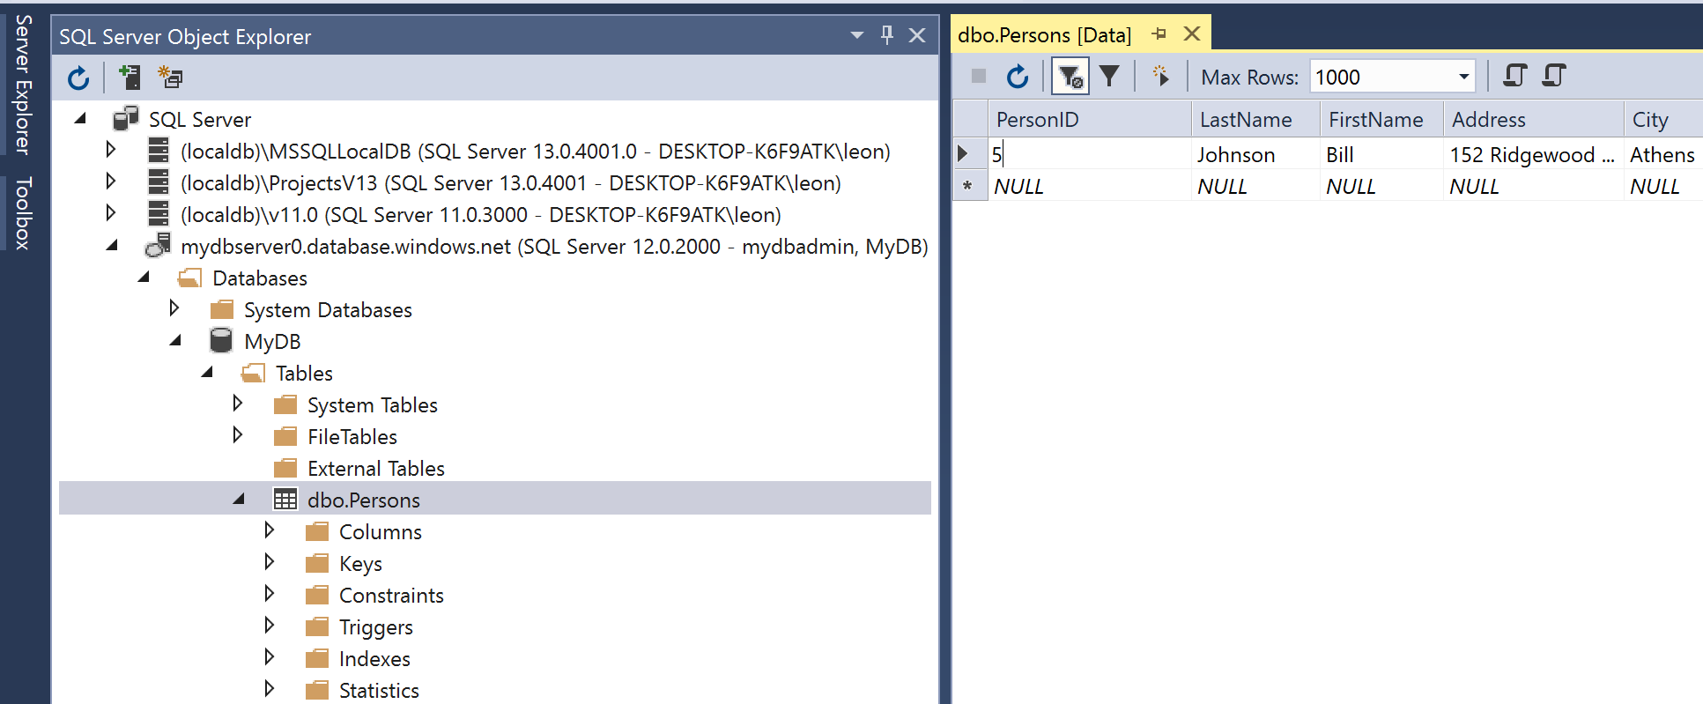
Table’s Data View
To see data of a table,
Right-click and then select “View Data”
Data in Table Persons

Slide 7
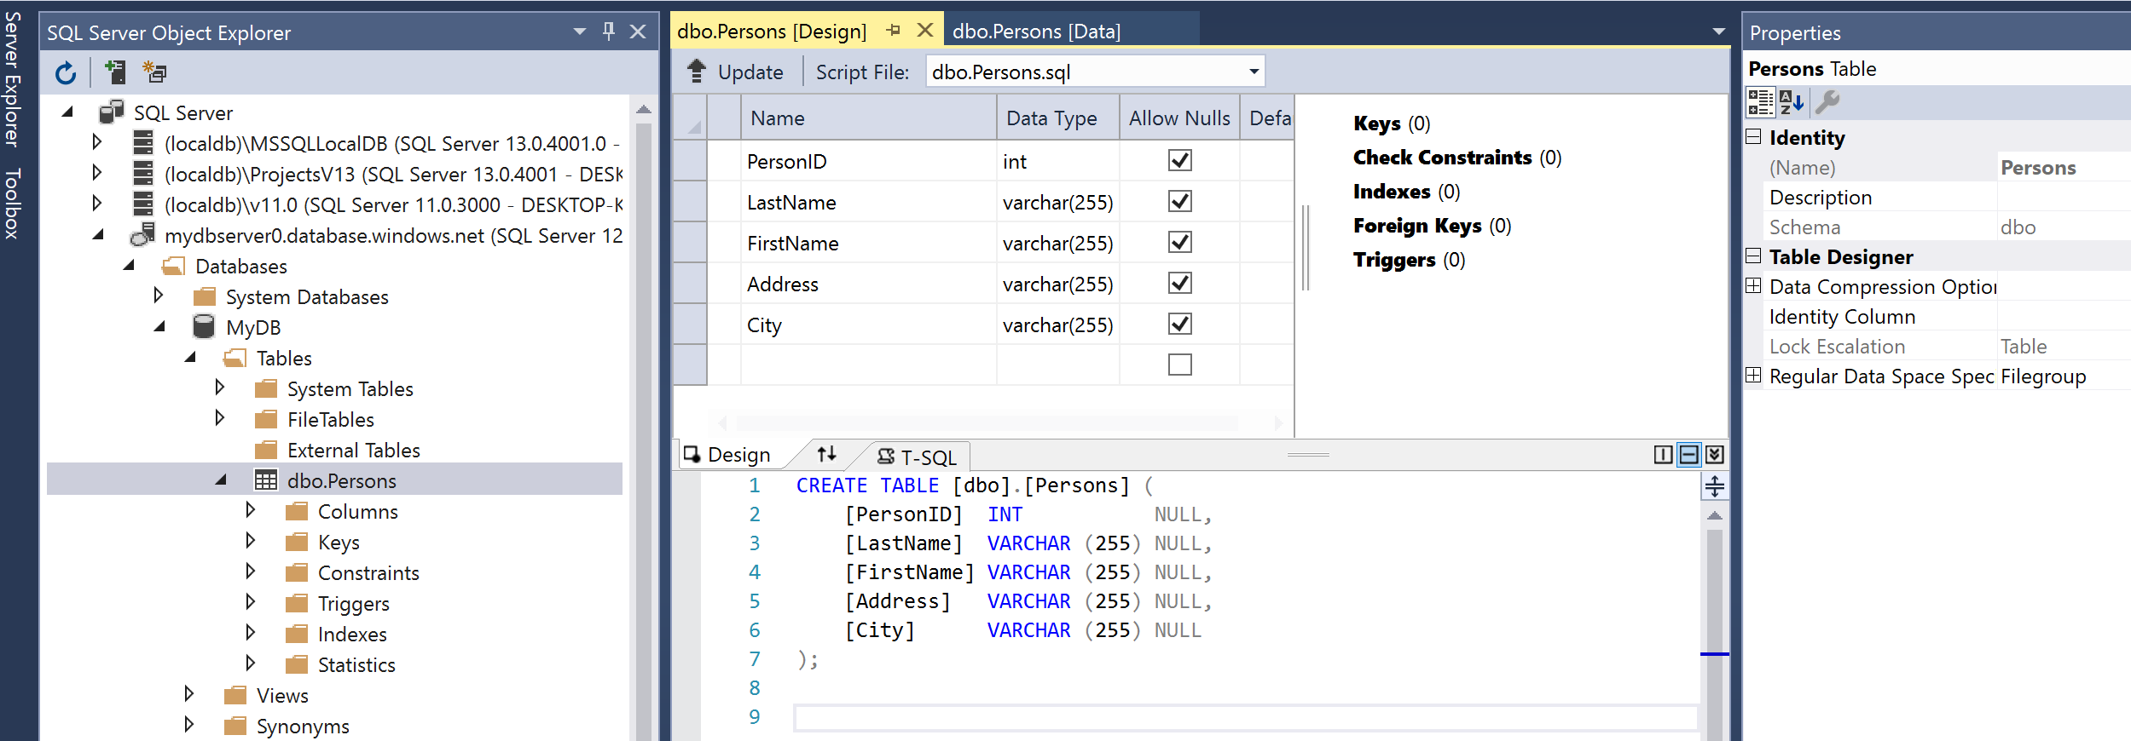
Table’s Design View
To see the table’s meta data,
Right-click and then select “View Designer”
Table Design

Slide 8
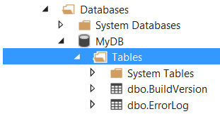
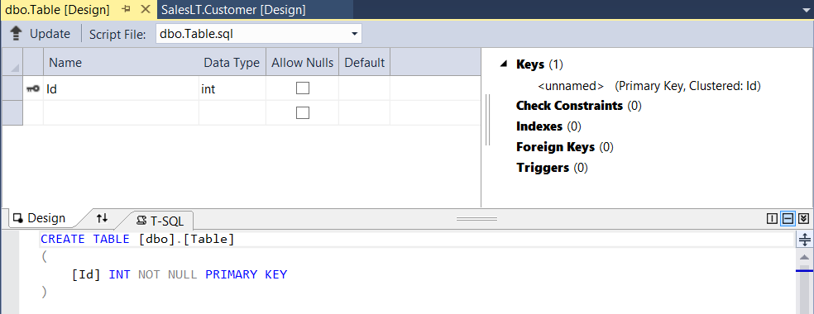
Creating a New Table
Right Click &
Select “add New Table …”

Slide 9
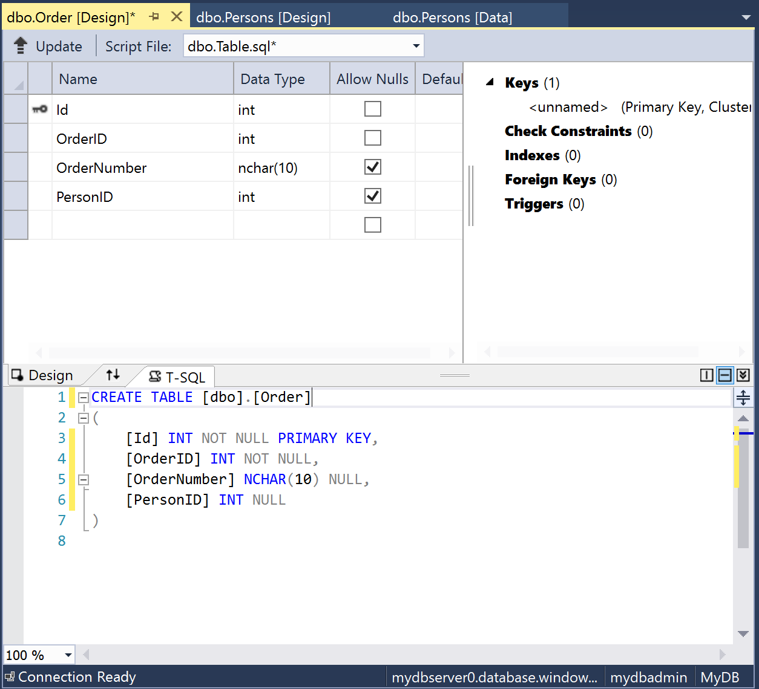
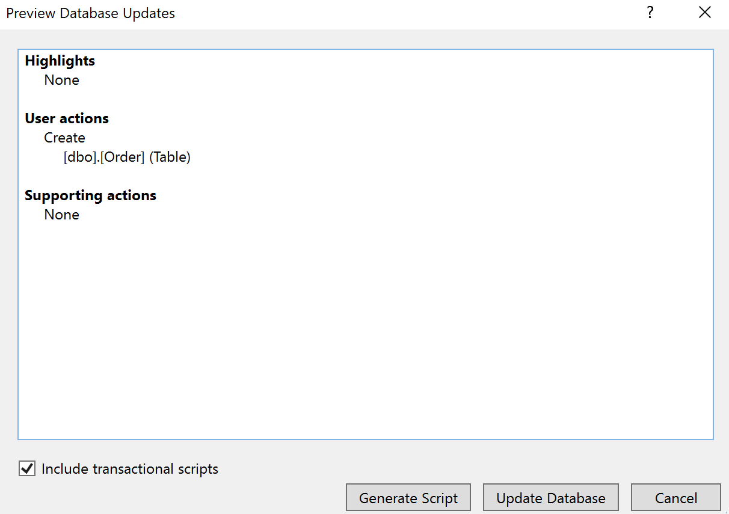
Creating a New Table (cont’d)

Slide 10
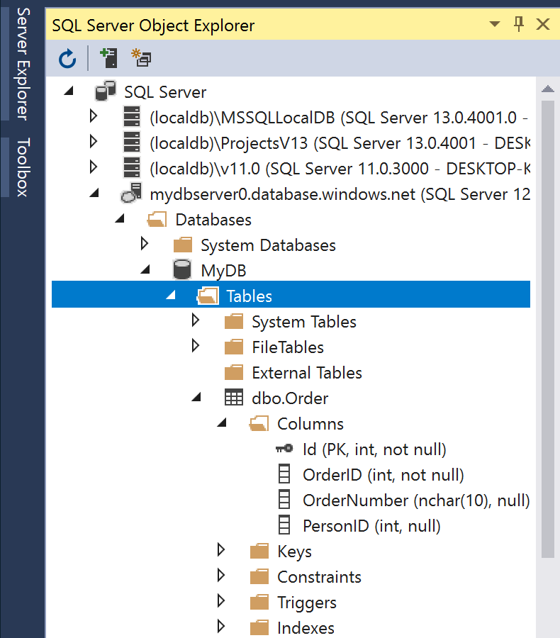
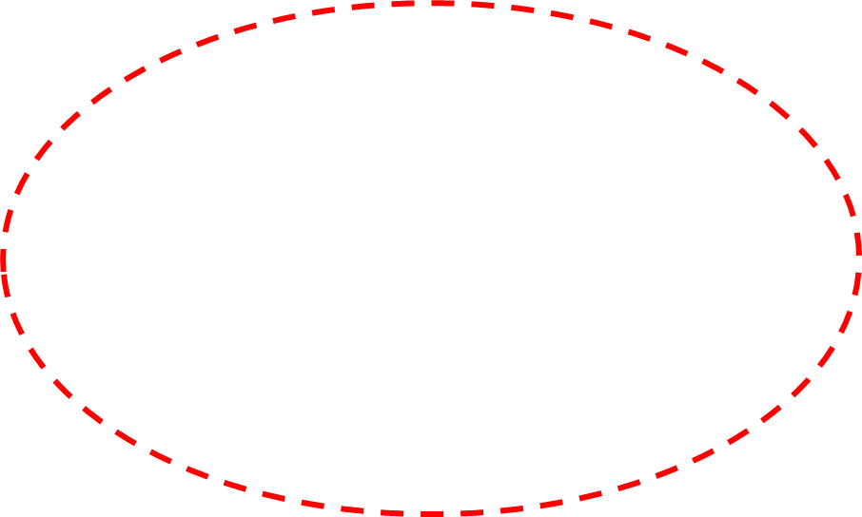
New Table “Order” Inserted into Database

Slide 11
Editing Data in Tables
Right-click the table’s name in SQL Server Object Explorer, and select View Data to launch data editor.
You can revert changes to a cell by pressing ESC
You can view your edits as a script by clicking the Script button on the toolbar.
Alternatively, you can use the Script to File button to save them in a .sql script file to be executed later.

Slide 12
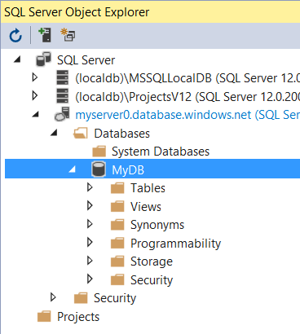
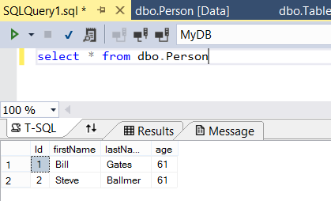
Executing Queries
1
Right Click &
Select “New Query …”
3
2
4

Slide 13
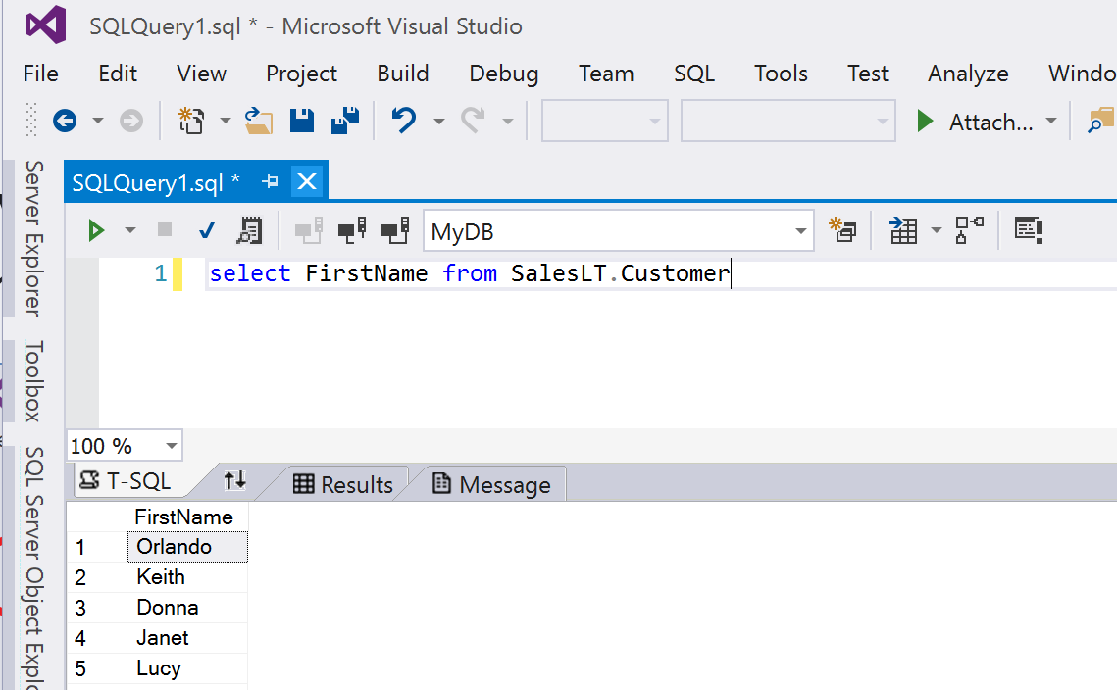
Creating a Query
Right-click the database in SQL Server Object Explorer, and select New Query.
Type select FirstName from dbo.Person and press the Execute Query button to return the data

Slide 14
A Cloud-Based Two-Tier Architecture
Web tier: Virtual machines can only initiate connections to the database logic machines and can only accept connections from the Internet.
Database tier: Virtual machines cannot initiate connection with anything outside of their own subnet and can only accept connections from the Web tier.

Slide 15
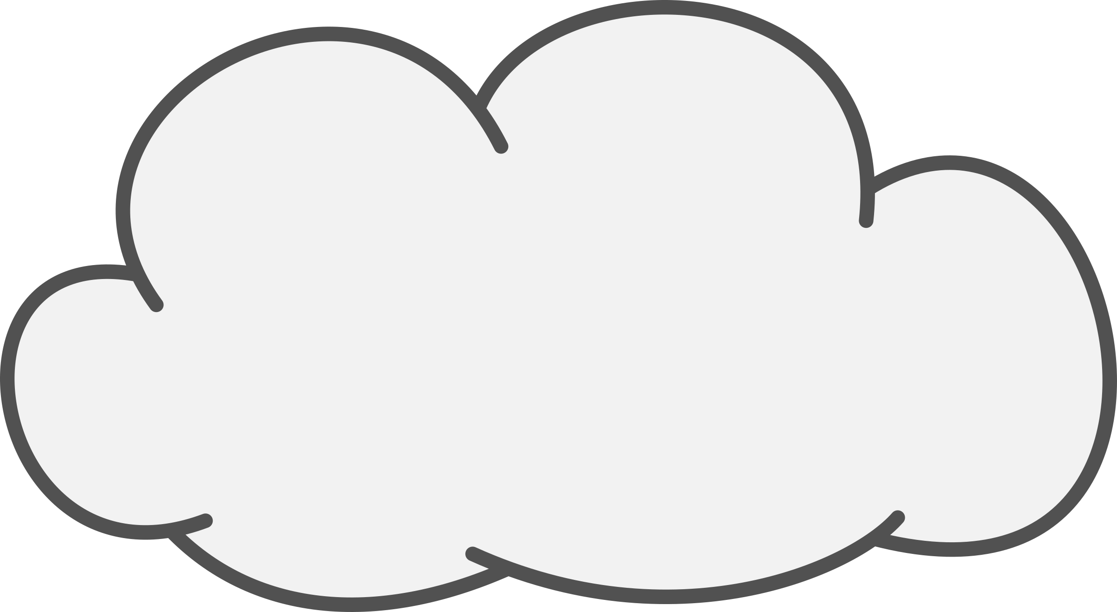

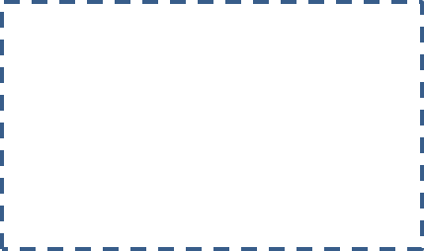


Subnet 2 (NSG-2)
Subnet 1 (NSG-1)
Web Server
Database Server
Public IP
Virtual Network
The Cloud
Client

Slide 16
Design Overview
Create a virtual network (MyVnet) with an address space of 10.12.0.0/22.
The address space of the virtual network is: 10.12.0.0 through 10.12.3.255 (1024 IP addresses).
Create a subnet for restricted access (backendSubnet) with an address range 10.12.0.0/24, i.e. 10.12.0.0 – 10.12.0.255. This gives us a total of 256 addresses.
Create a network security group (NSG-2) to limit access to the subnet. First, we want to prevent any Internet access to the subnet. Second, we will allow SQL access to the subnet but only from a specific subnet (frontendSubnet).

Slide 17
Create a second subnet (frontendSubnet) where the Web server will reside: 10.12.3.0/24, i.e. 10.12.3.0 – 10.12.3.255 (256 IP addresses).
Create a network security group (NSG-1) for frontendSubnet, configured with restricted access: allowing only RDP (port 3389) and HTTP (port 80) traffic.
Create a Virtual Machine in the frontendSubnet. Install a web server.

Slide 18
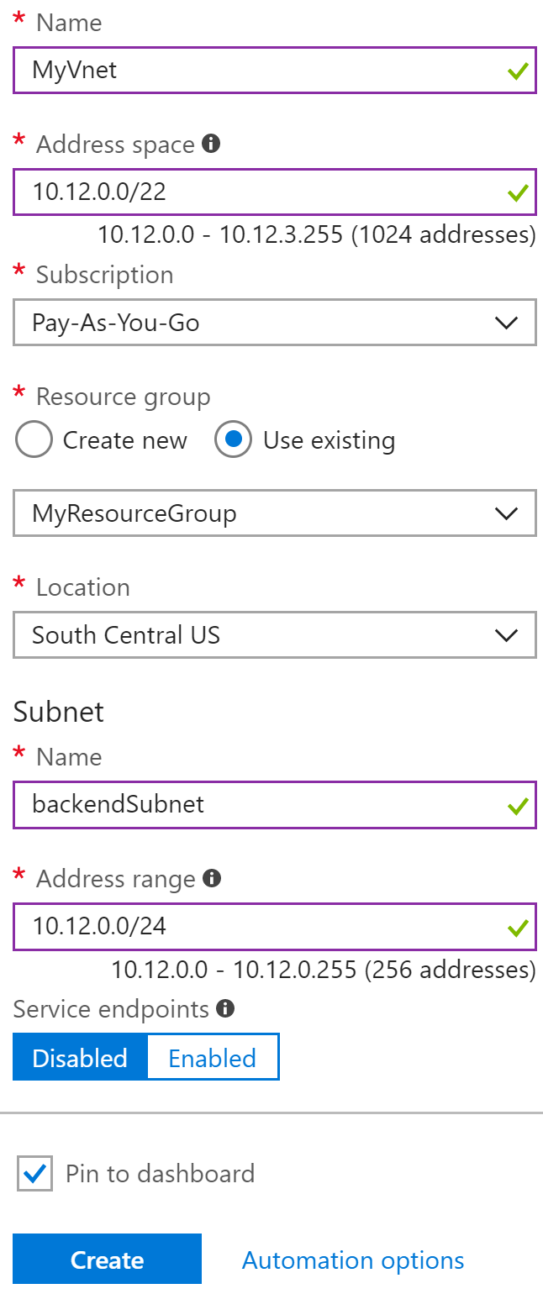
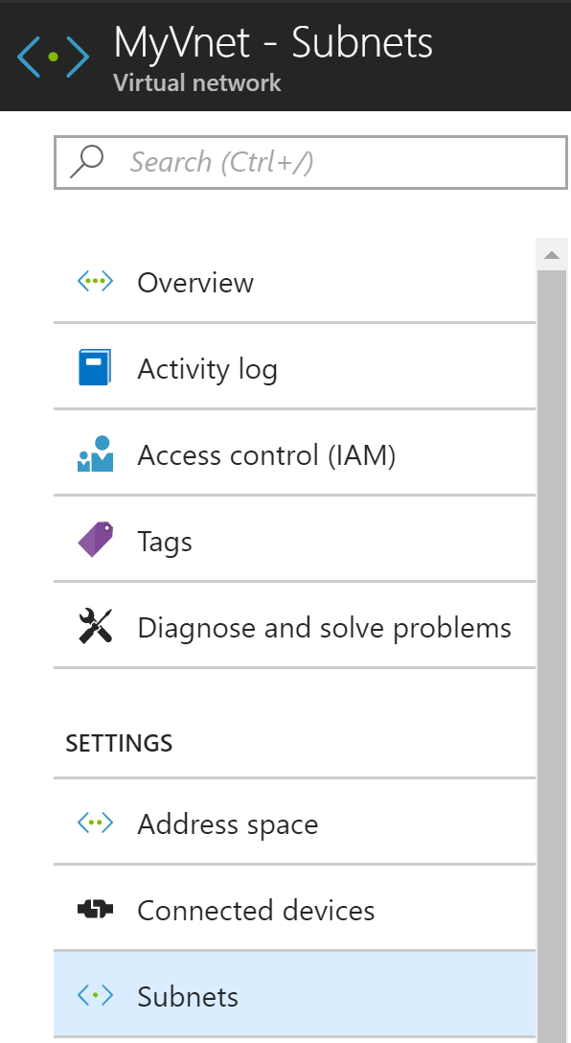
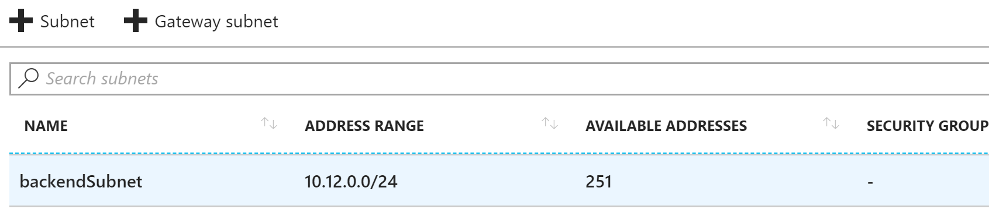
After Creating
Virtual Network
With Subnet
No Security Group on Subnet

Slide 19
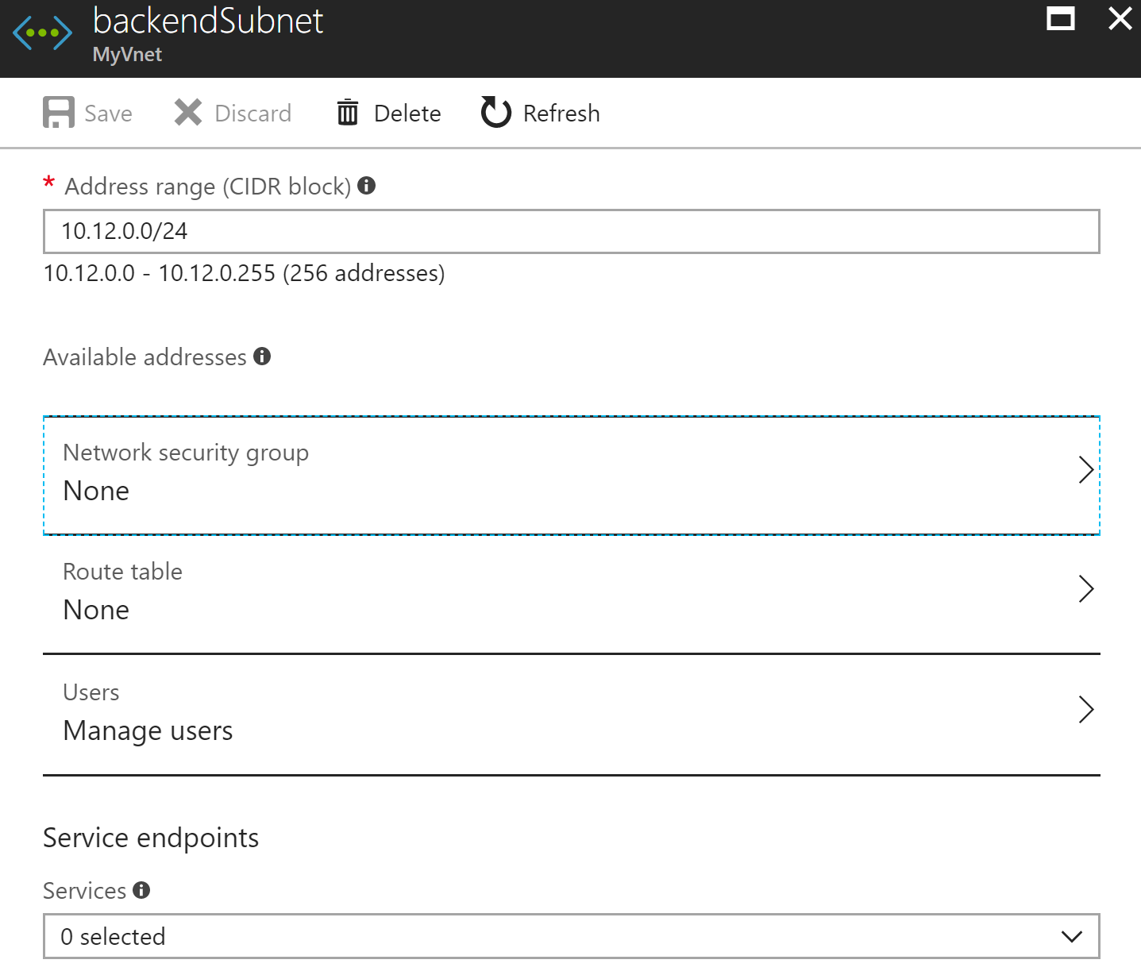
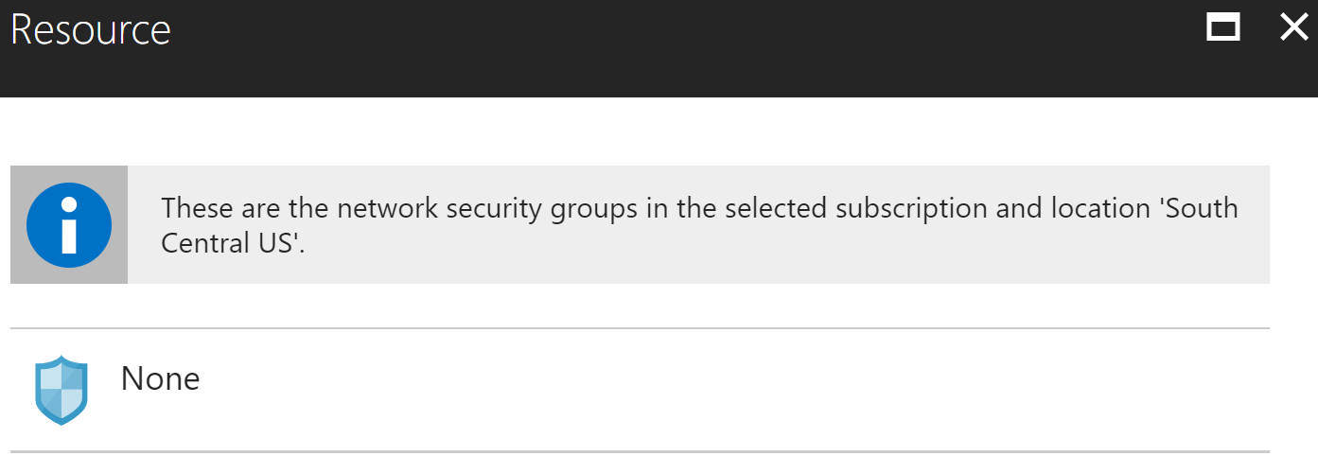
We need
to create a Network Security Group (NSG) on this subnet

Slide 20
Network Security Group (NSG)
You can use an NSG to control traffic to one or more virtual machines (VMs) in a virtual network.
An NSG contains access control rules that allow or deny traffic based on traffic direction, protocol, source address and port, and destination address and port.
The rules of an NSG can be changed at any time, and changes are applied to all associated instances.

Slide 21
We want to create NSGs for each of the two subnets (NSG1 and NSG2) in the MyVnet virtual network:
NSG-1: The front end NSG. It is applied to the FrontendSubnet, and consists of two rules:
rdp-rule: To allow RDP traffic.
web-rule: To allow HTTP traffic.
NSG-2: The back end NSG. It is applied to the backendSubnet, and consists of two rules:
sql-rule: To allow SQL traffic only from the FrontendSubnet.
web-rule: To deny all internet bound traffic from the backendSubnet.

Slide 22
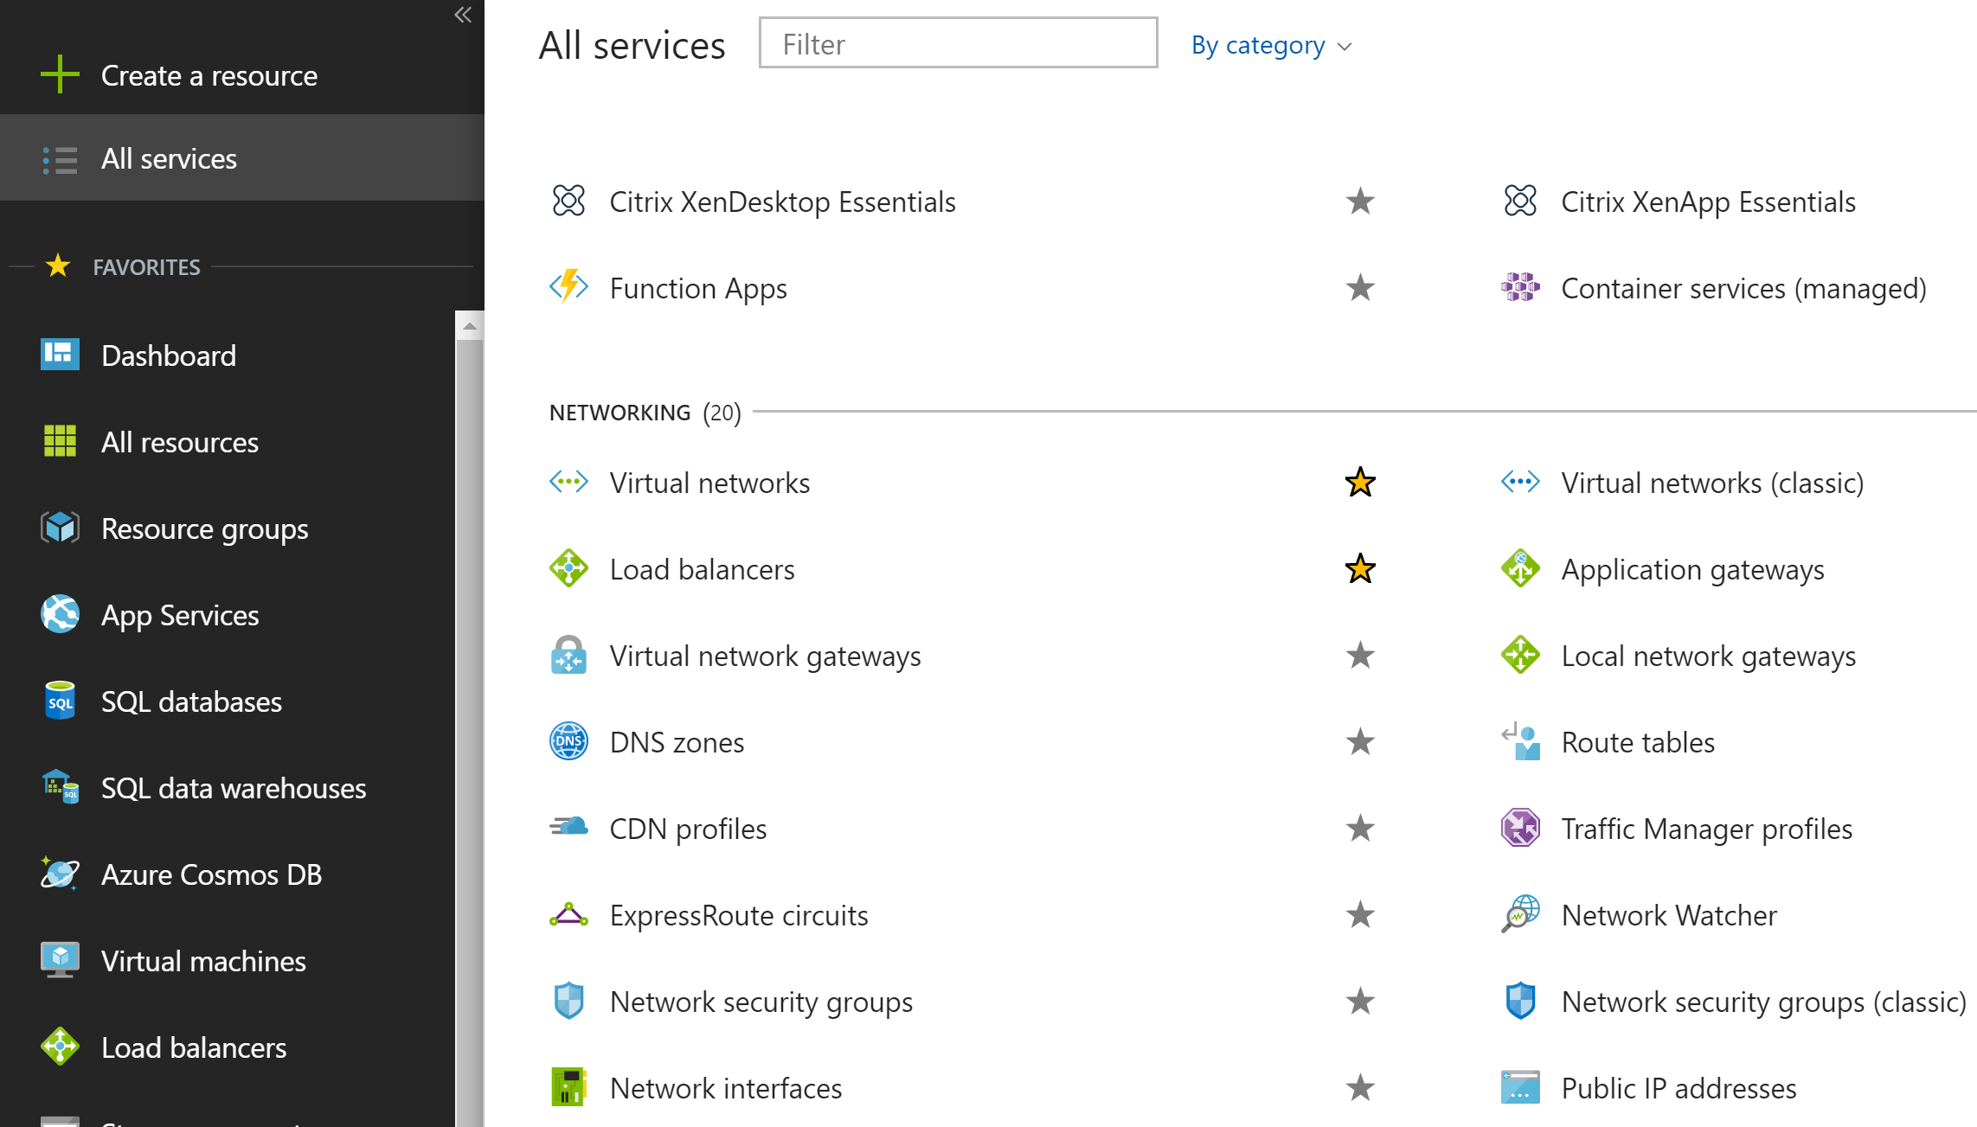
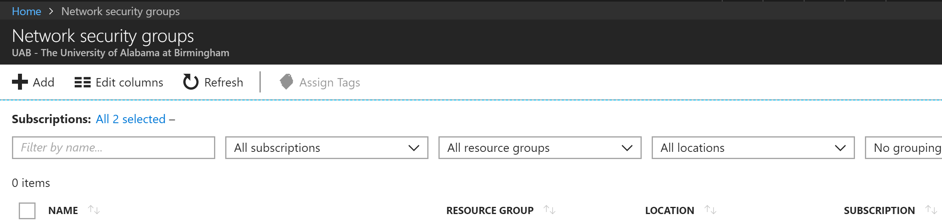
1
2
3

Slide 23
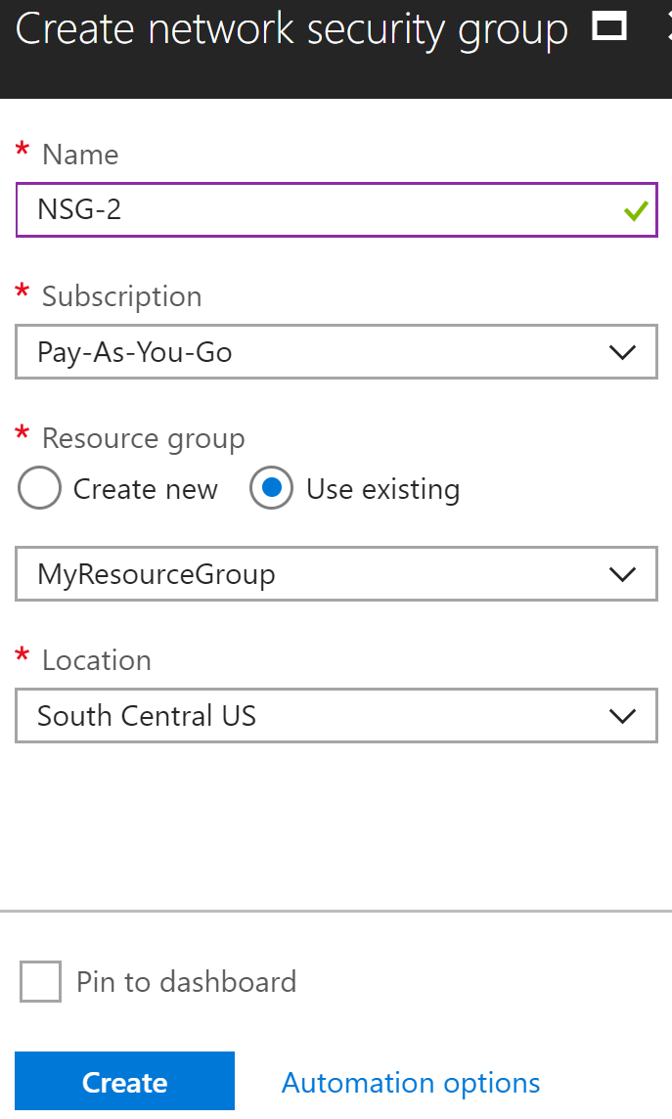
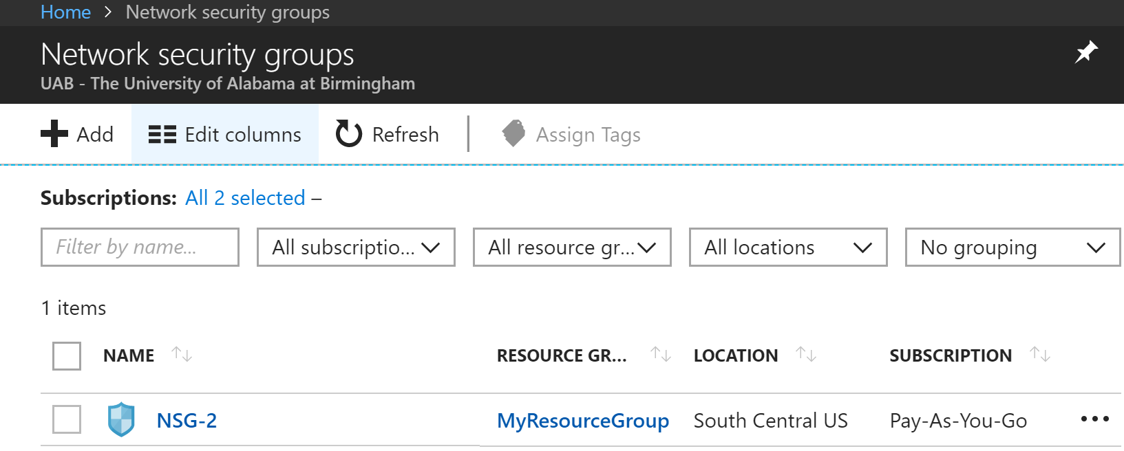

Slide 24
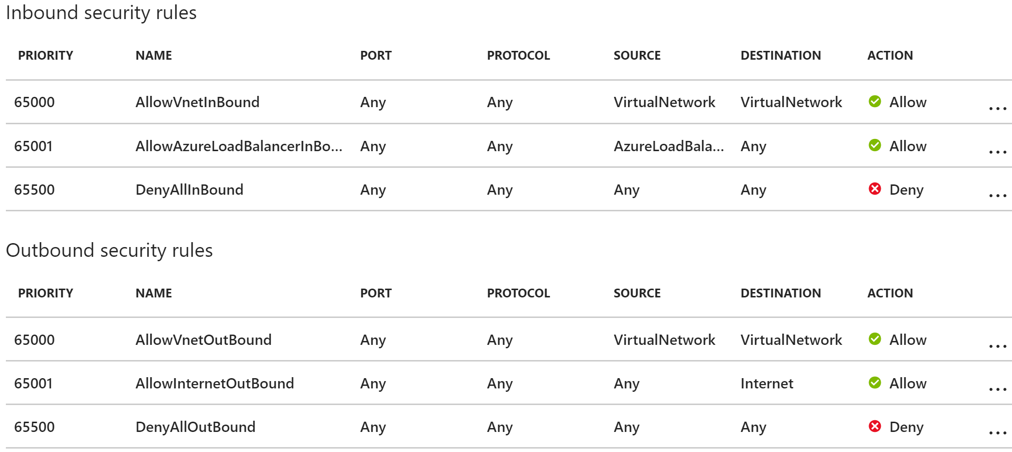
We need to add additional rules to NSG-2, as described earlier: 1) Inbound rule to restrict only to port 1433 from subnet 10.12.3.0/24 2) Outbound rule to deny access to any incoming Internet traffic.
NSG-2 Created with Default Rules

Slide 25
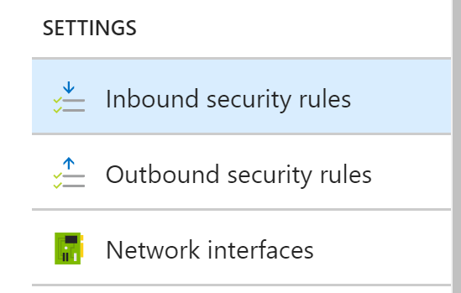
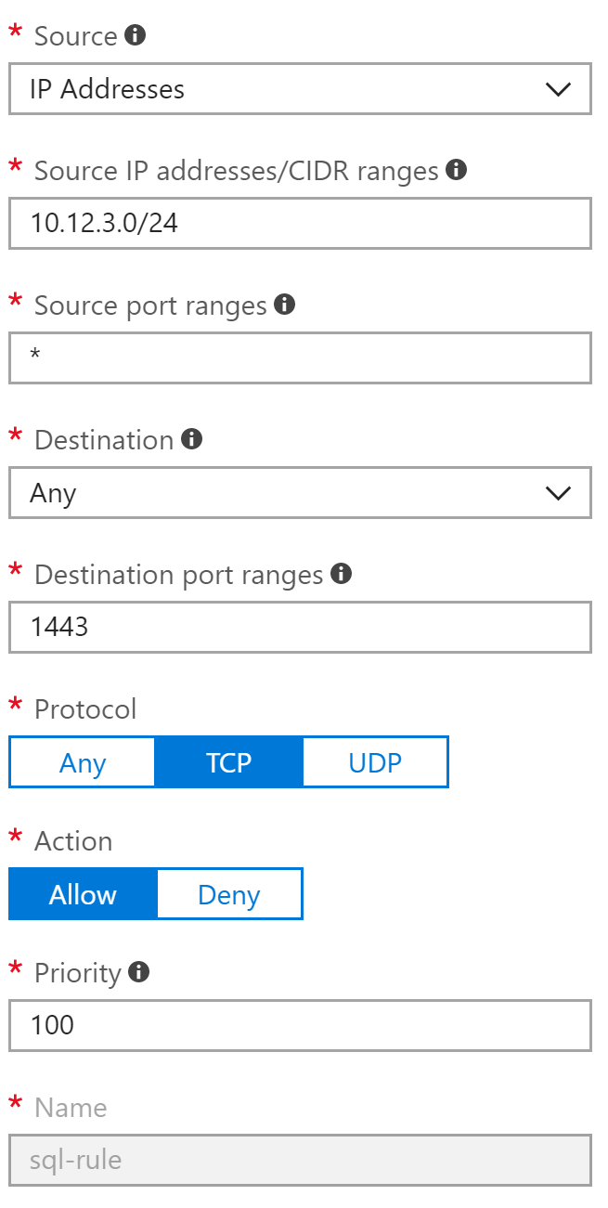
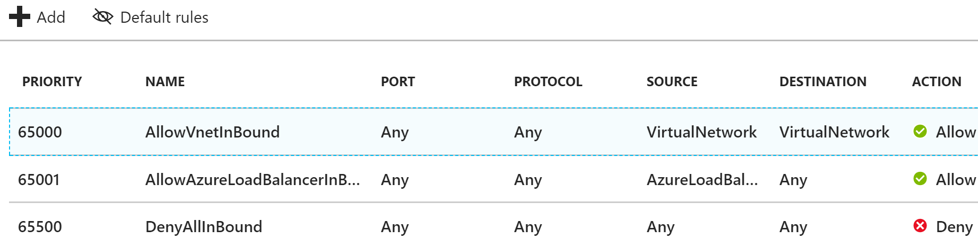
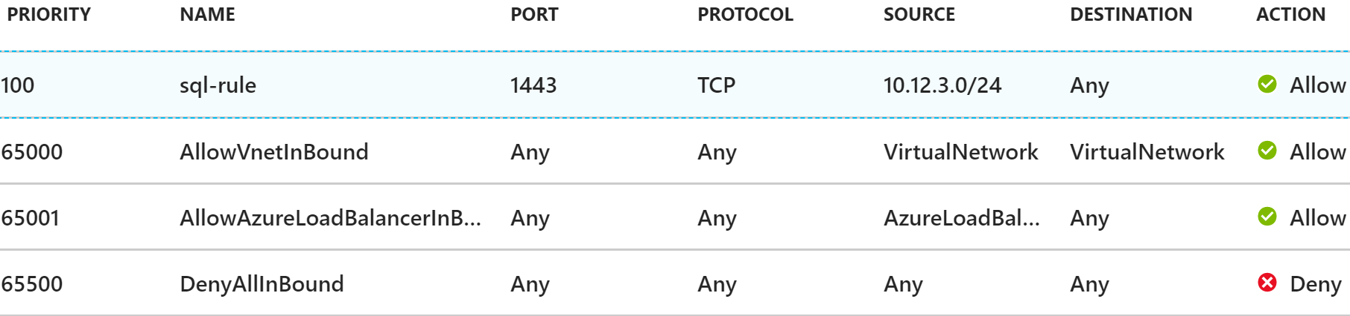
1
2
3

Slide 26
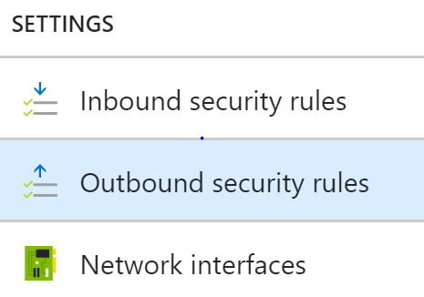
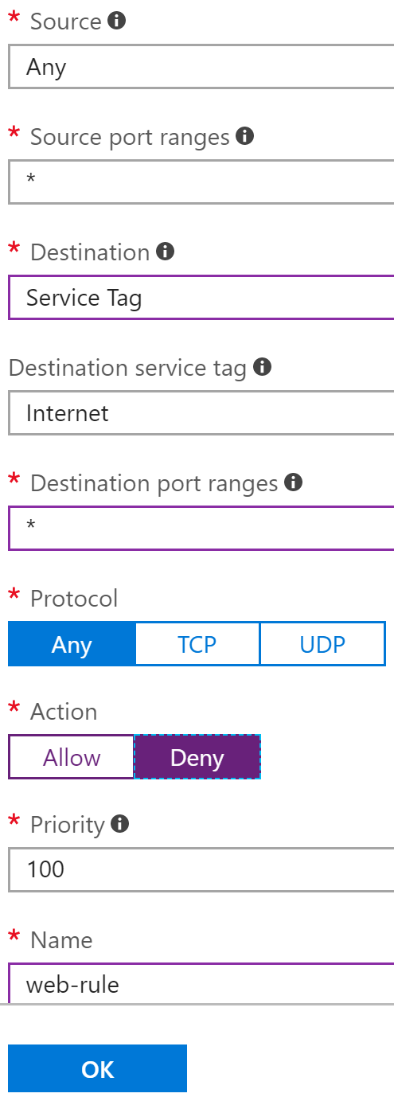
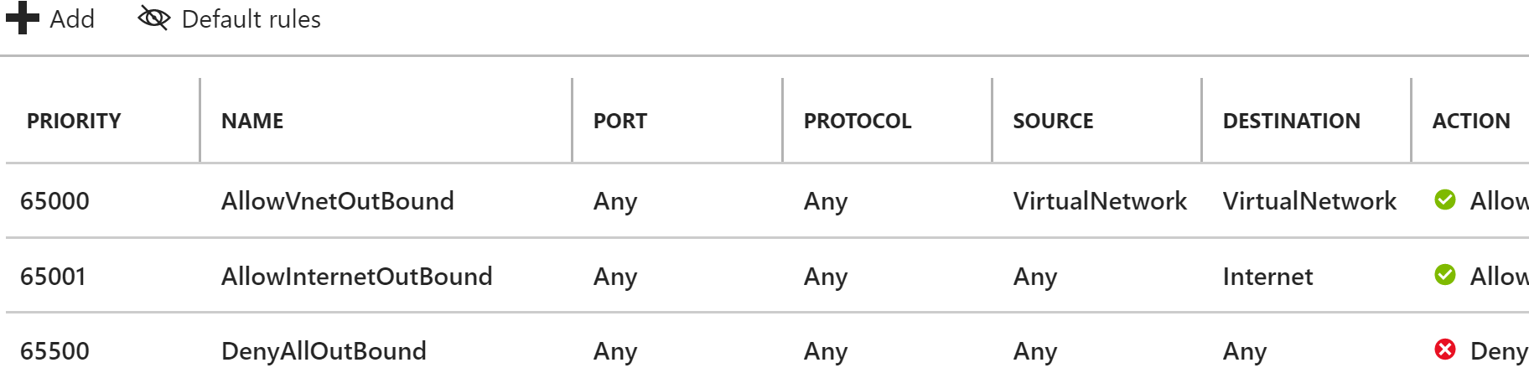
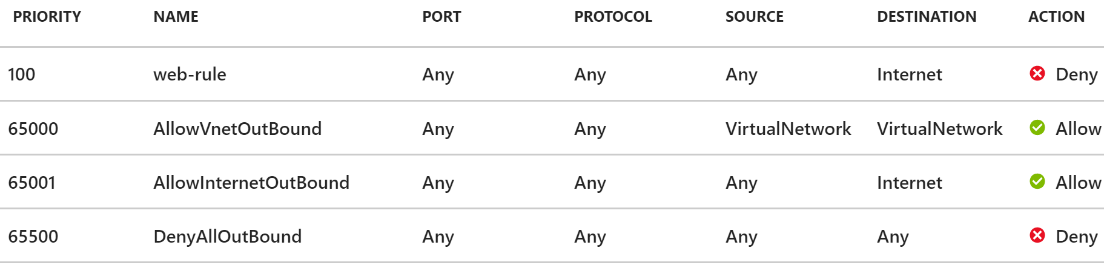
1

Slide 27
Summary
Completed Steps :
Created a virtual Network (MyVnet).
Created a subnet within MyVnet (backendSubnet).
Created and configured an NSG (NSG-2)
Next Steps:
Create a second subnet (frontendSubnet)
Create an NSG for this subnet (NSG-1)
Configure subnet for restricted access, as discussed earlier: allow RDP and HTTP traffic.

Slide 28
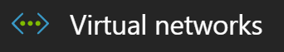
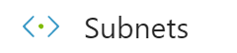
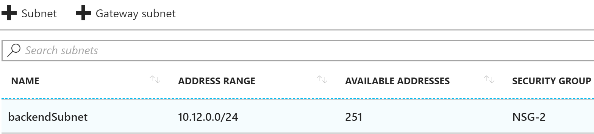
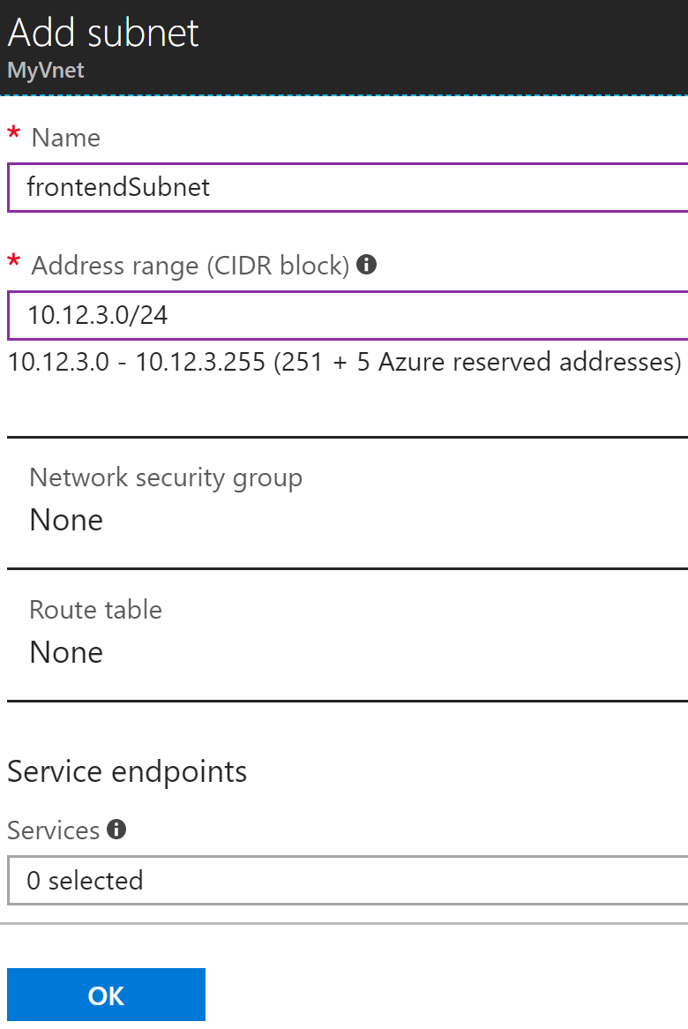
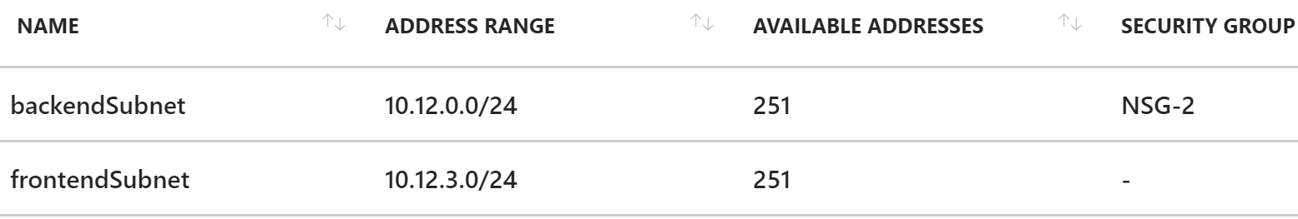
Creating the Second Subnet: frontendSubnet
Navigate: →

Slide 29
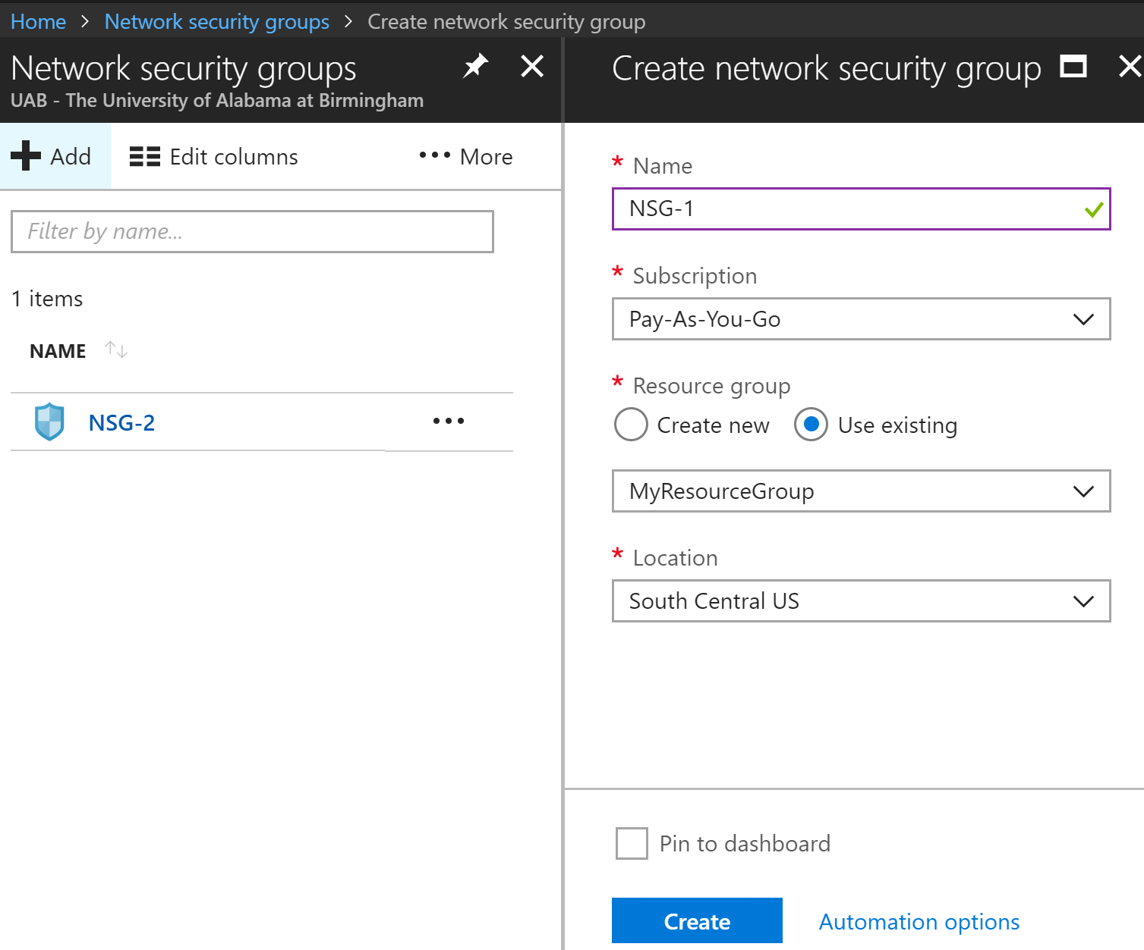
Creating the NSG (NSG-1) for frontendSubnet
Next Step:
Create rules for NSG-1
Associate NSG-1 with frontendSubnet

Slide 30
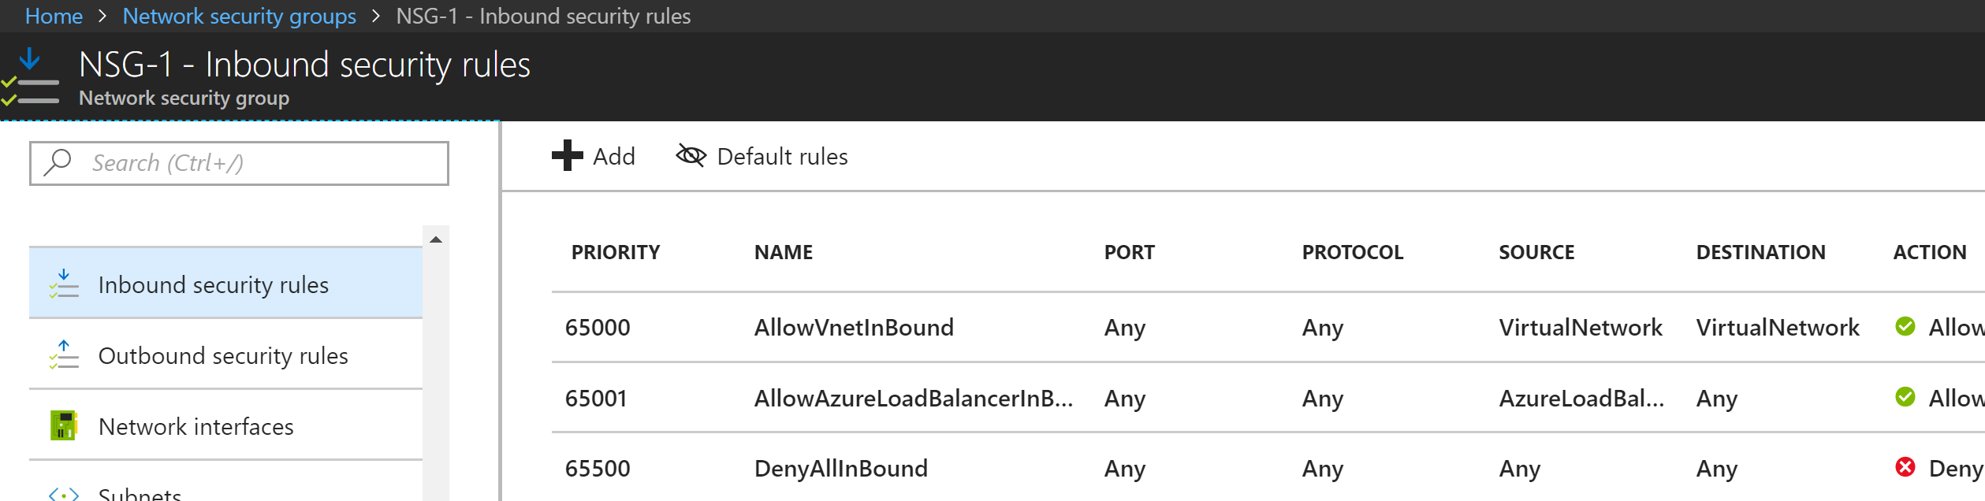
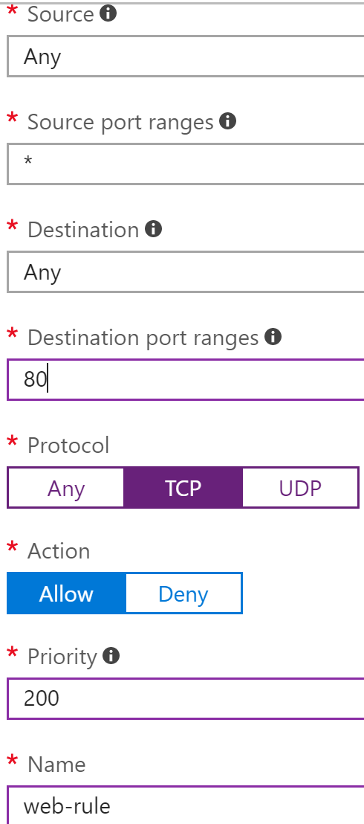
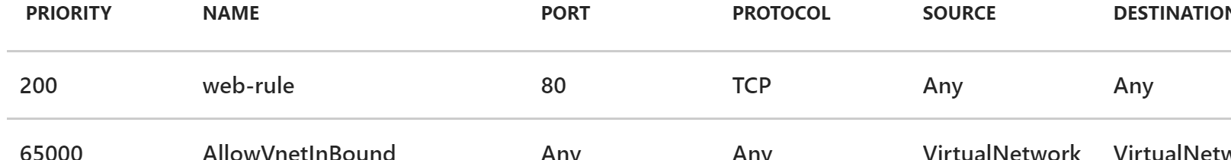

Slide 31
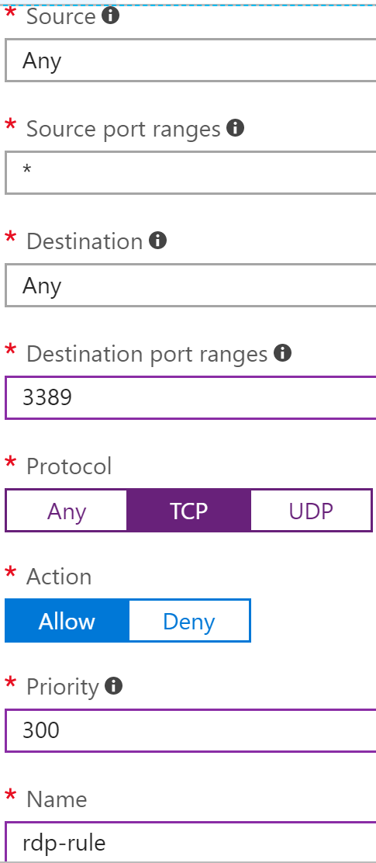
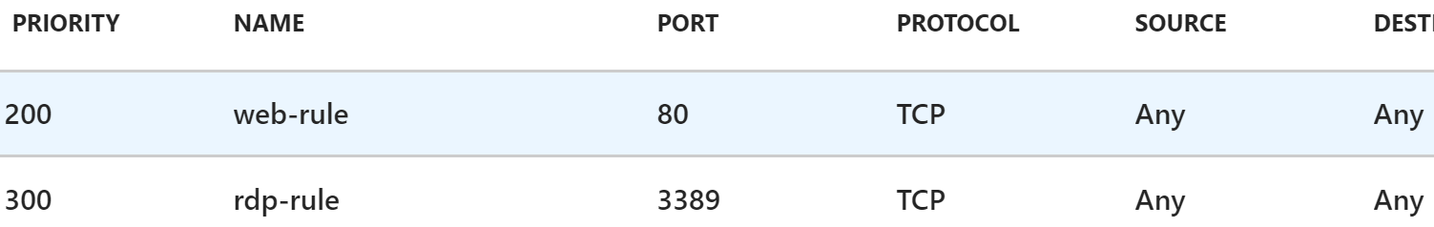
We create an inbound rule (rdp-rule) allowing access via TCP to port 3389 to any VM from any source, with priority of 300 .

Slide 32
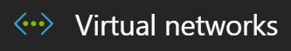
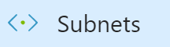



Associate the NSG (NSG-1) with frontendSubnet
Navigate: →

Slide 33


Slide 34



Web Server

Slide 35
Virtual Network Service Endpoints
Service endpoints can be configured on each subnet in a virtual network.
For a subnet, you can only configure one service endpoint to a service.
Endpoints work with any type of compute instances running within that subnet.
You can configure multiple service endpoints for all supported Azure services (Azure Storage, or Azure Sql Database, for example) on a subnet.
Virtual networks must be in the same region as the Azure service resource.

Slide 36
Setting up Service Endpoints for existing subnets in a Virtual Network
In resources, navigate and select an existing Virtual Network
Click on “Service endpoints”
Click “Add”
Select “Service”
Select the subnet where you want to apply the endpoint
Click “Add”

Slide 37


1
2

Slide 38




2
3
1

Slide 39

You can also delete a service endpoint

Slide 40


Slide 41
Create a Virtual Network Rule in the Azure SQL Database
The rule tells your SQL Database to accept communication from a particular subnet that has been tagged as being a Virtual Network service endpoint:
Navigate to SQL servers → Firewall / Virtual Networks.
Set the Allow access to Azure services control to OFF.
Click the + Add existing control, in the ”Virtual networks” section.
In the “Create/Update” pane, fill in the controls with the names of your Azure resources.
Verify that the resulting virtual network rule on the firewall pane was set up.

Slide 42




Slide 43


